Slide 1



Superstore Data Analysis Report
- Prajwal Jadhao

Slide 2






Project Overview :
Objective
Data Set
Methodology
Key focus areas
Conclusion and recommendations

Slide 3

Objective :
Analyze retail sales data to derive insights into customer behavior, popular products, and sales trends.

Slide 4
Data Set :
The Data set used in this project is the Sample Superstore Sales data.
Scope of Data set :
Sales transactions
Product details
Customer Information
Order details
Financial metrics

Slide 5


Methodology:
Data Acquisition and Preparation:
Data Import: Used Power BI to connect to the dataset and import it into the Power BI data model.
Data Cleaning: Performed data cleaning tasks to address missing values, handle duplicates, and ensure data quality for analysis.
Data Transformation: Applied data transformations like formatting data types, creating calculated columns to prepare the dataset for analysis.

Slide 6

Exploratory Data Analysis (EDA) :
Explored the dataset using Power BI's data view to understand its structure and contents.
Calculated basic descriptive statistics like sum, average and displayed it using charts.
Visualization and Analysis:
Selected appropriate visualizations like bar charts, line charts to represent key metrics and trends.
Created dashboard and report in Power BI to visualize sales patterns, customer segments, and product performance.
Used analysis methods like customer segmentation, time series analysis, product analysis etc.

Slide 7

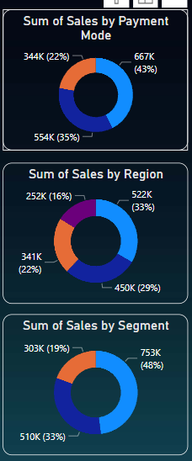
Key Focus Areas:
Descriptive Statistics:
Calculated basic descriptive statistical metrics like Total sales, Total profit, Total quantity and average delivery days .
Visualized the distribution of sales by payment modes, segment, region etc using doughnut charts.

Slide 8
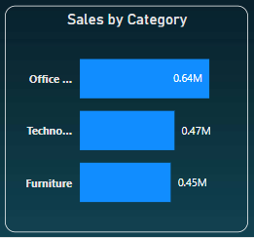
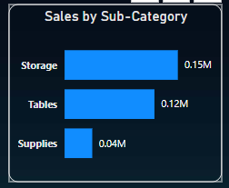
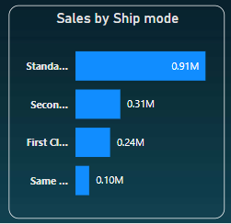
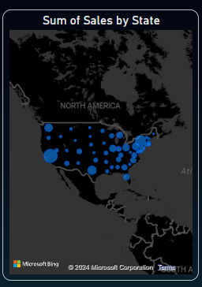
Product Analysis :
Performed detailed analysis on finding the top selling products according to category and sub-category.
Calculated Total Sales for every region and total sales according to the ship modes used.

Slide 9
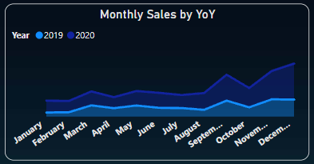
Time Series Analysis:
Conducted analysis on yearly sales trend using area chart over monthly time period.

Slide 10
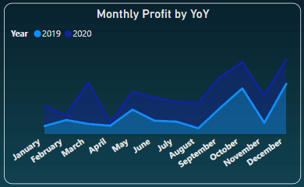
Visualized monthly profit all over the year with help of area chart showing difference in profit margins over time.

Slide 11
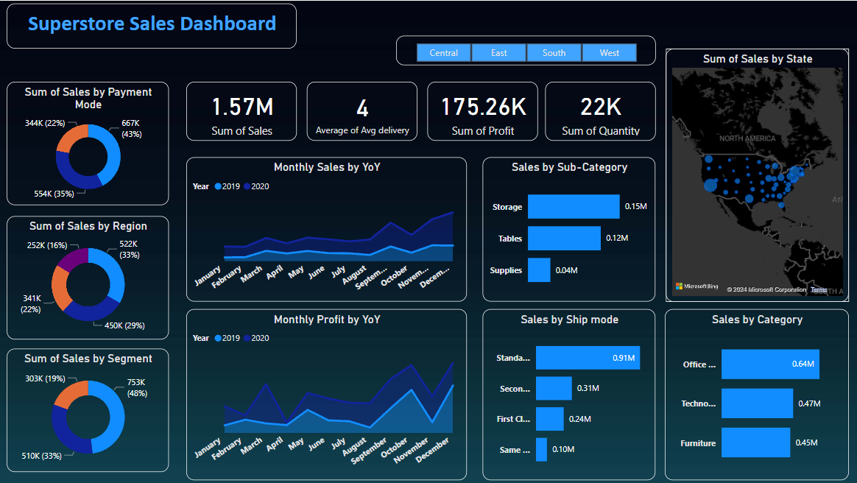
Dashboard

Slide 12
Conclusion:
After analyzing the Superstore sales data using Power BI, we've gained valuable insights that can inform business decisions and strategies.
Key Findings:
The Western region emerged as a strong performer, particularly in the Office Supplies category.
By segmenting customers, we discovered distinct purchasing behaviors, offering opportunities for targeted marketing and personalized engagement.

Slide 13
Implications for Business Strategy:
Our findings suggest a potential to expand product offerings in high-demand categories to meet customer preferences.
Implementing dynamic pricing based on customer segments could optimize revenue and enhance customer satisfaction.

Slide 14
Recommendations:
For Improvement
Enhance inventory management practices for top-selling products to minimize stockouts and improve supply chain efficiency.
Explore advanced forecasting techniques to anticipate sales trends and optimize inventory planning.

Slide 15

Thank you!

